Slide 1
Automating Performance Metrics for Quality Improvement in Complex Chronic Disease
Presenters
Funded by VA HSR&D
Views expressed are those of speaker and not necessarily those of Dept of Veterans Affairs

Slide 2
AutoPM Project Team
Mary Goldstein, MD, MS^{1,2}
Paul Heidenreich, MD ¹
Susana Martins, MD MSc ¹
Robert Coleman, MS Pharm
Amy Furman, PharmD ¹
Samson Tu, MS ²
Dan Wang, PhD ¹
Tyson Holmes, PhD ²
Ali Corley ¹
¹ VA Palo Alto Health Care System, Palo Alto, CA
² Stanford University, Stanford, CA
Notes:
Affiliations?

Slide 3
AutoPM Goals
Use the VISN21 Dashboard as a platform to provide clinical decision support (CDS) to Patient-Aligned Care Teams (PACTs)
Integrate clinical practice guidelines (CPGs) across multiple chronic conditions
Build upon previous work with ATHENA-CDS to generate recommendations for treatment of patients with complex clinical scenarios

Slide 4
5 Clinical Conditions
Hypertension
Hyperlipidemia
Chronic Kidney Disease
Cardiovascular Disease
Diabetes Mellitus

Slide 5
Clinical Context of our work
  Populations are aging worldwide
Older adults tend to have multiple chronic conditions
  75 million people in the US have two or more concurrent chronic conditions
  65% of Medicare beneficiaries have 2 or more chronic conditions
  48% have at least 3
  21% have 5 or more
Notes:
We began to notice in the late 90s that there was an increase in the complexity of medical care. Patients often have multiple co-existing chronic diseases. Sometimes each disease requires several medications so that the overall number of medications is high. The amount of clinical data generated within the electronic systems can be overwhelming, especially when patients have several diagnoses, for example, hypertension, coronary artery disease, and diabetes, as so many patients do. The amount of medical literature is huge and growing all the time, with new clinical trial data appearing frequently.
We began working a decade ago to find ways to bring information technology and clinical care together to give health professionals the information they need as they work with patients.

Slide 6
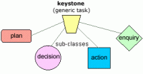


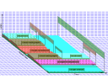
Role of Clinical Practice Guidelines
Clinical practice guidelines define
evidence-based best practices and performance measurement
Lots of work has been done to automate
Almost all CPGs—and all systems to automate treatment in accordance with CPGs—focus on single diseases

Slide 7
ATHENA- CDS
A guideline model-based approach to develop CDS systems based on single guidelines
Used EON model as the format for encoding CPGs in Protégé based Knowledge Bases (KB) for individual clinical conditions*
Initially created to provide CDS for hypertension (ATHENA-HTN)
Notes:
CPGs are encoded in Protégé based KB, EON…reword,
*ask Samson about wording

Slide 8
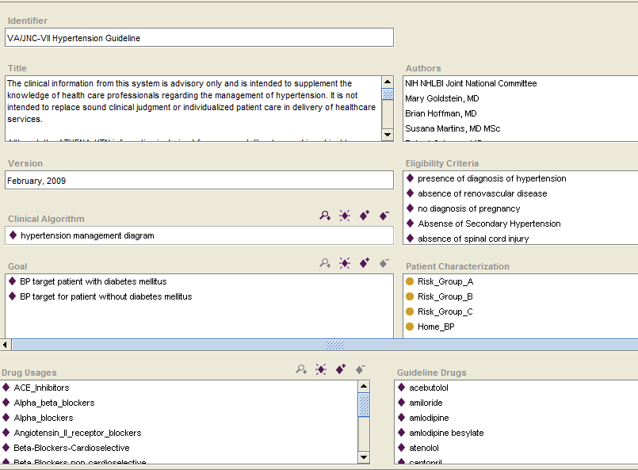
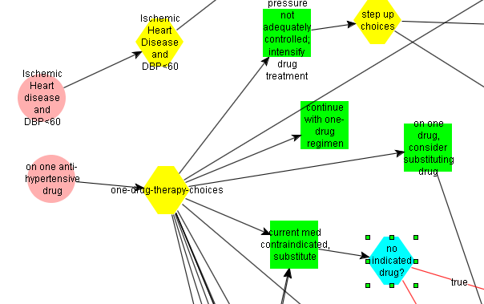
Encoding Clinical Knowledge into Computable Form:
ATHENA HTN Knowledge Base
Notes:
Show blender
Very technical- maybe put at end

Slide 9
Simplified ATHENA Architecture
Electronic Medical Record
System Patient Data
VISTA
Hierarchical
Database in M
Conclusions; Treatment
Recommendation
CPRS
Guideline
Interpreter
(execution engine)
ATHENA
HTN Guideline
Knowledge Base
SQL Server:
Relational database
Data Mediator
Notes:
TIH: Slide clear of PHI 3.4.2011
Just for technical

Slide 10
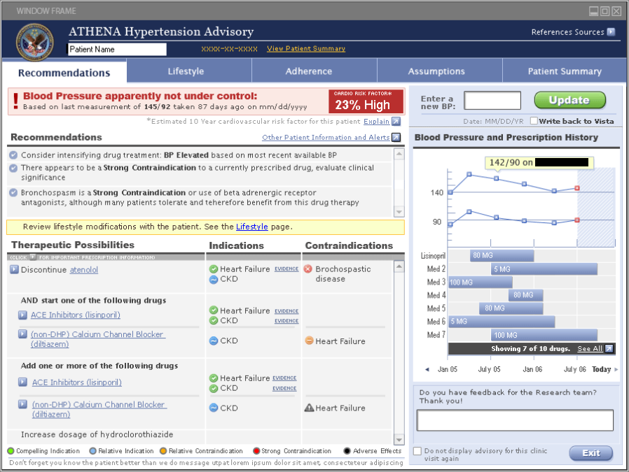
SYNTHETIC PATIENT DATA
Notes:
Advisory vs pop up: advisory would be better term

Slide 11
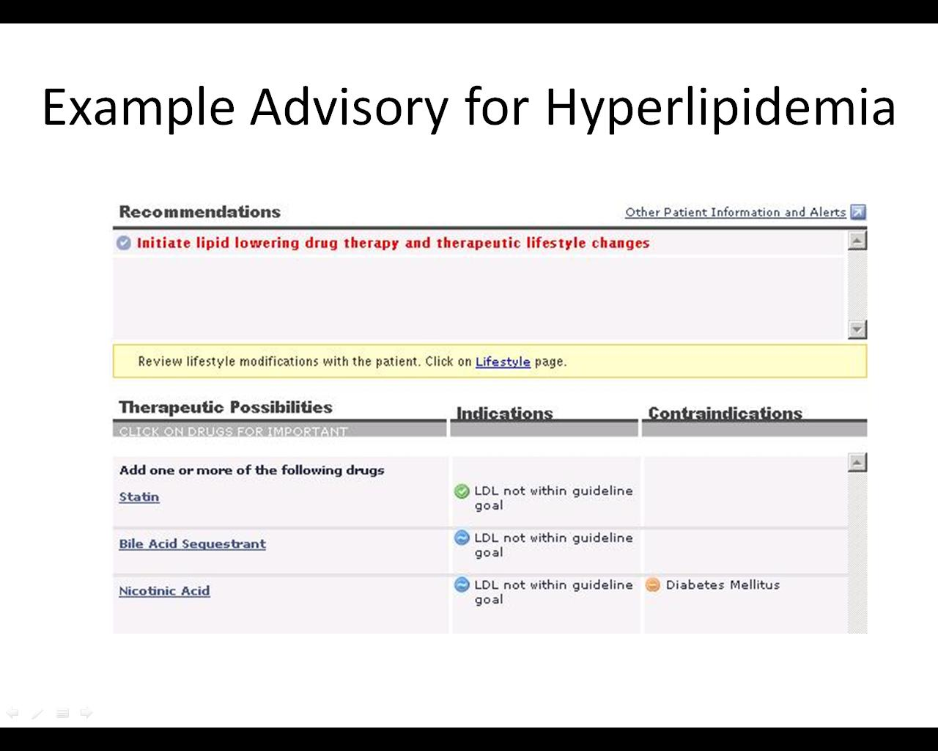

Slide 12
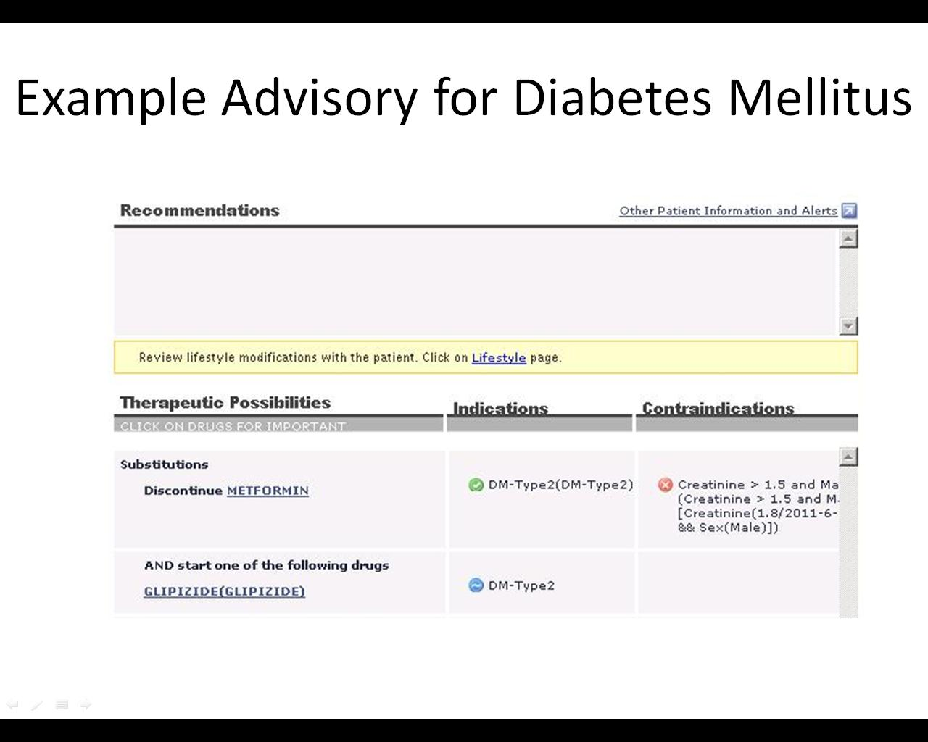

Slide 13
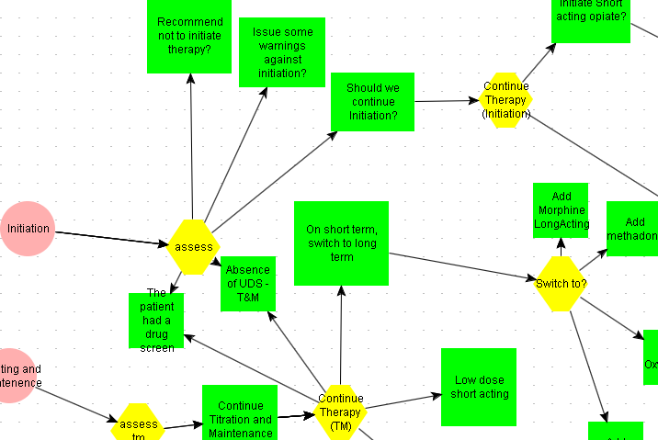
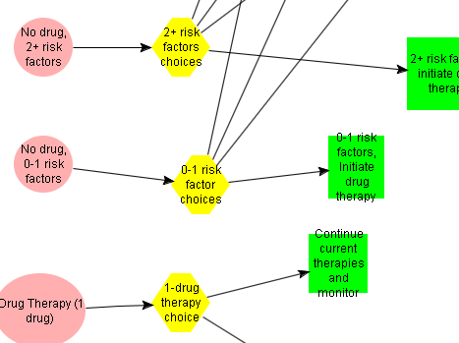
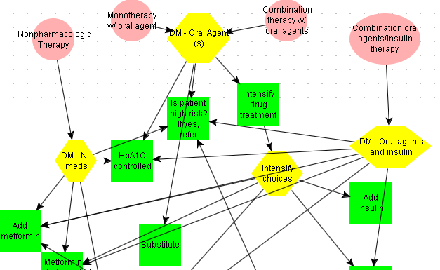
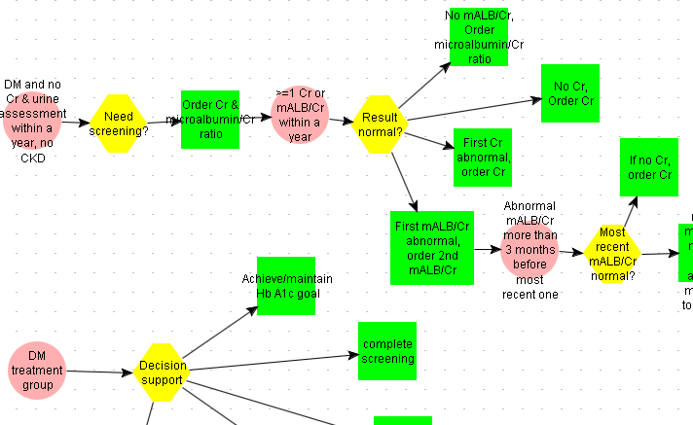
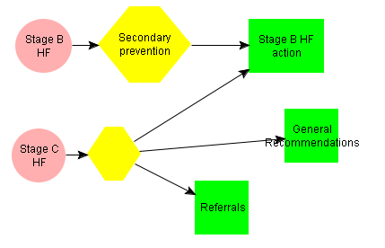
Encoded Guidelines
These KBs have been previously deployed
ATHENA Hypertension
ATHENA Opioid Therapy
ATHENA Hyperlipidemia
ATHENA Diabetes
ATHENA Kidney Disease
ATHENA Heart Failure
Notes:
Knowledge bases for several other clinical domains have since been developed
Need to guide stakeholder through this slide
Just for technical

Slide 14
Hypothetical older patient: Patient suffers from a typical set of multiple chronic diseases
Applying each of the separate CPGs would cause the patient to take:
12 separate medications
19 doses per day taken at 5 different times
one weekly medication
Boyd CM, Darer J, Boult C, Fried LP, Boult L, Wu AW. Clinical practice guidelines and quality of care for older patients with multiple comorbid diseases. JAMA 2005;294:716-24.
Notes:
Boyd CM, Darer J, Boult C, Fried LP, Boult L, Wu AW. Clinical practice guidelines and
quality of care for older patients with multiple comorbid diseases. JAMA 2005;294:716-24.
reference at bottom
Hypothetical 79-year-old woman with chronic obstructive pulmonary disease, Type 2 diabetes, osteoporosis, hypertension, and osteoarthritis

Slide 15
Care for patients with multiple chronic conditions
Integrating CPGs for patients with multi-morbidity presents challenging problems:
  Competing therapeutic goals
  Interventions that interact
  Difficulty achieving parsimonious treatment plans
Further research is needed to develop systems that support both coordination of guidelines and prioritization of recommendations
Notes:
NEEDS WORK-should we bring this up here?- maybe move to later meetings

Slide 16
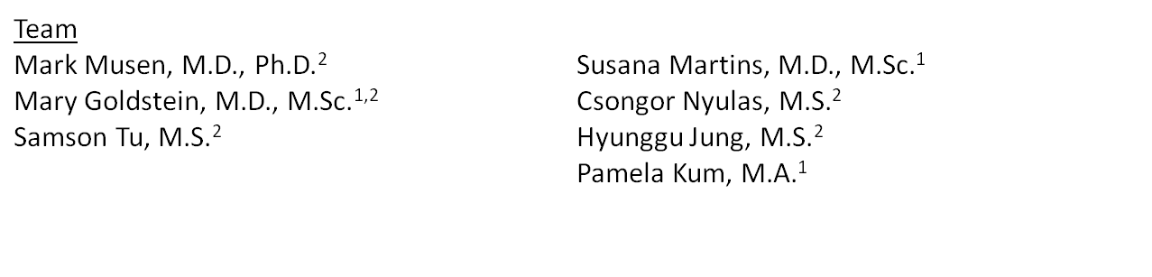
GLINDA Project: Automated Reasoning for Application of Clinical Guidelines http://glinda-project.stanford.edu
Computational methods for reasoning about evidence-based practice
Mechanisms for dealing with the fuzziness of clinical situations
  Application of multiple clinical-practice guidelines
  Adjustments for patient co-morbidities
  Adjustments for interactions among interventions
¹ VA Palo Alto Health Care System, Palo Alto, CA
² Stanford University, Stanford, CA
Notes:
Text might be too complex-use regular language and simplify
Clinicians-which disease/therapy to prioritize and what are challenges that they encounter
Use for technical

Slide 17
Prioritizing the Recommendations
Incorporate patient preferences
  For health outcomes
  For specific treatments
  For treatment of specific diseases
  Other
Compare how much different treatments will be expected to improve health/well-being
Consider how well each guideline applies to this patient
Need stakeholder input to prioritize recommendations
Notes:
When showing this slide- can ask stakeholders questions about how to prioritize recommendations

Slide 18
VISN21 Dashboard
Veterans Integrated Service Network (VISN) 21 Pharmacy Benefits Management (PBM) group developed a clinical data warehouse
Can be used to monitor/evaluate performance while also providing tools to improve performance
Uses stoplight type report to notify users if patients are not meeting targets established by VA performance measures
Notes:
Can ask stakeholders if they are familiar with dashboard/how they use it in their regular practice

Slide 19
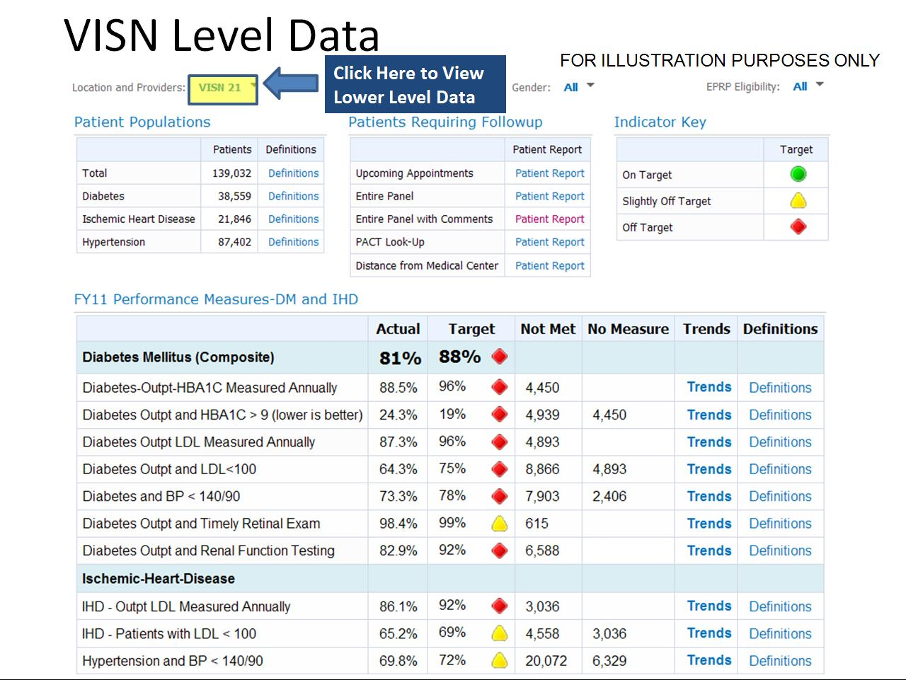
Notes:
Picture adjusted by AMC using Hypersnap 1/23/12

Slide 20
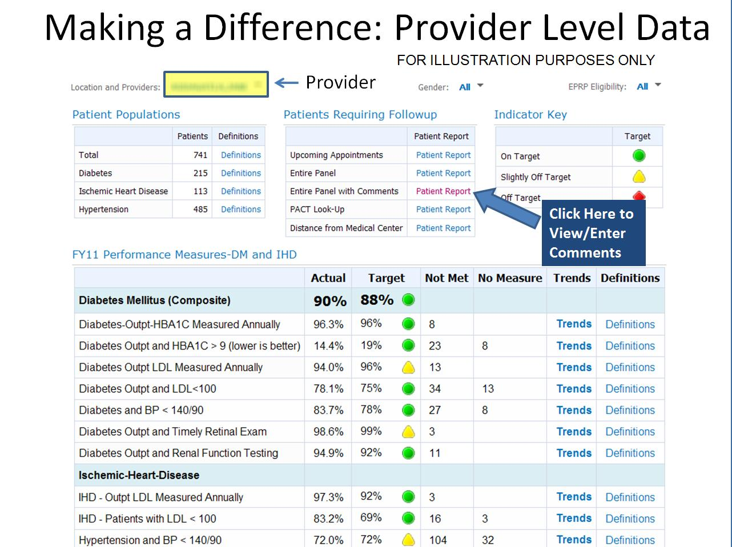

Notes:
Here is the dashboard showing data for an individual provider’s patients. The structure of this page is the same as the VISN level page-same PMs, same report options
Users can click on different reports in the top middle. One report allows users to enter comments about individual patients
Picture adjusted by AMC using Hypersnap 1/19/12

Slide 21
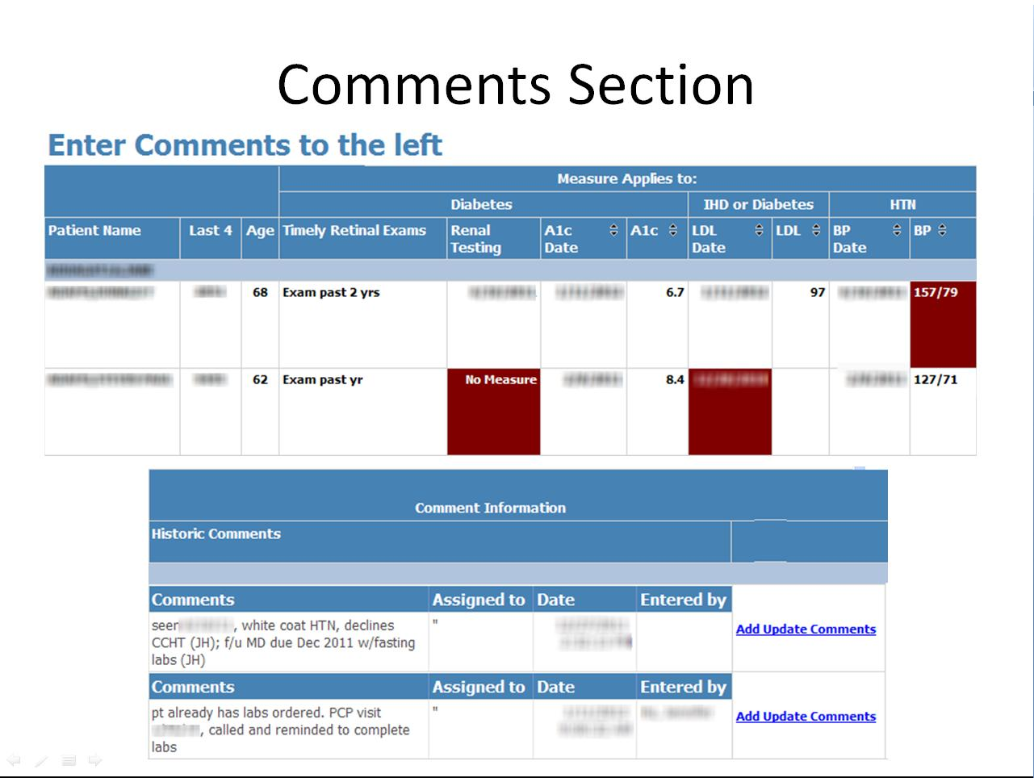
Notes:
The comments section opens after clicking on the link on the previous page. Here, users can see which patients are failing performance measures and can insert comments next to each patient.
Comments can also be assigned to anyone in the PACT team to assist in distributing tasks amongst the different PACT members.
Picture adjusted by AMC using Hypersnap 1/19/12

Slide 22
Team Approach for Utilization of Dashboard
The dashboard is used as bridge technology to rationalize chronic disease care
Direct physician input rarely required
Care can be delivered telephonically thus enhancing access
    Tools and process can be disseminated to other VA facilities
    Allows team members to work at the Top of their License while improving patient outcomes.

Slide 23
Data from the clinical dashboard allowed for identifying those patients who:
may have been lost to follow up
did not get their labs done in an appropriate time frame
need medication adjustment
need an appointment with nursing or pharmacy for more intensive education regarding disease state management or medication adherence

Slide 24
Incorporating CDS into the
VISN21 Dashboard
Use the Dashboard as a platform to provide CDS to Patient-Aligned Care Teams (PACTs)
Link ATHENA-CDS to VISN21 Dashboard
  Show recommendations when patients are failing a performance measure(s)
  Parse tasks to different PACT members
  Need stakeholder input to determine where and how to best display CDS
Notes:
When showing this slide- can ask stakeholders if about where to put CDS in dashboard-show them following slides for example

Slide 25
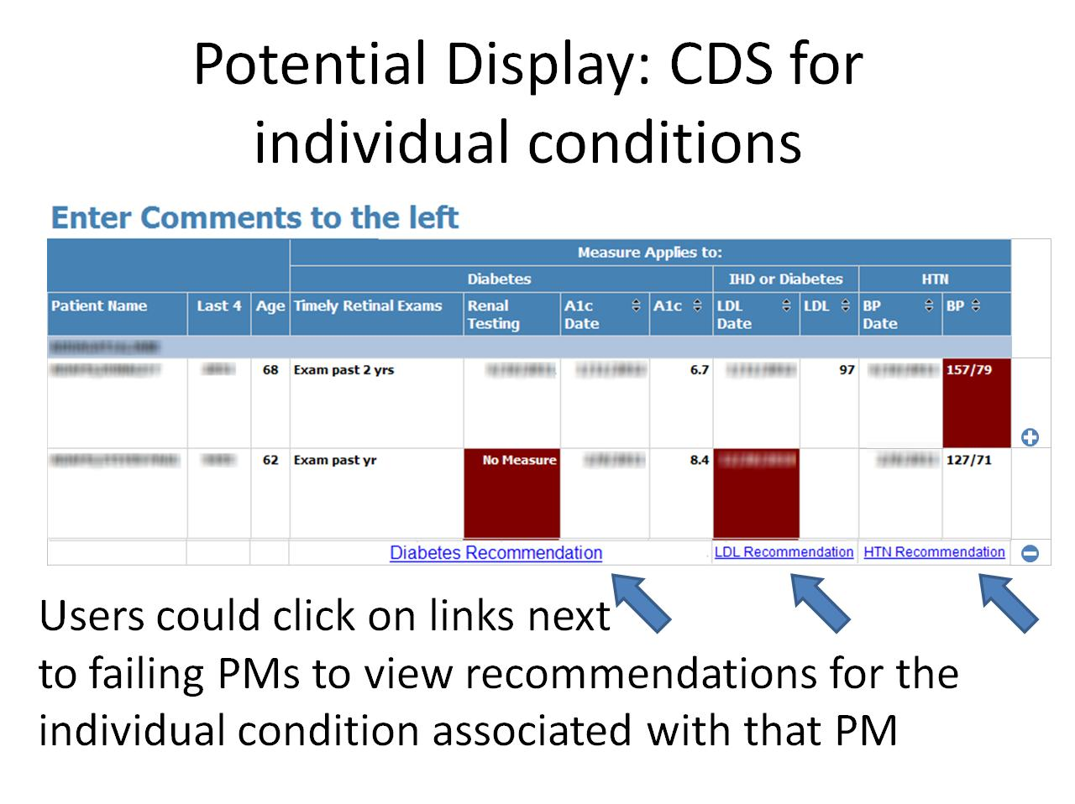
Notes:
In the early stages of the project, before we develop a method to integrate CDS for multiple diseases, we will only have the ability to show CDS for individual conditions. For this “work in progress” stage, we still look for feedback from stakeholders.
One possible place to integrate CDS into the dashboard could be in the comments section.
From the provider level data homepage, users can click on the “Entire Panel with Comments” report to view comments. We could potentially add links under failing PMs that would open an ATHENA Advisory that provides recommendations for that specific disease.
We could design the interface so that the links to the recommendations can be accessed by clicking on a plus sign, and similarly can be hidden by clicking a minus sign
This set-up would allow for multiple advisory windows to be open at the same time
Picture adjusted by AMC using Hypersnap 1/19/12

Slide 26
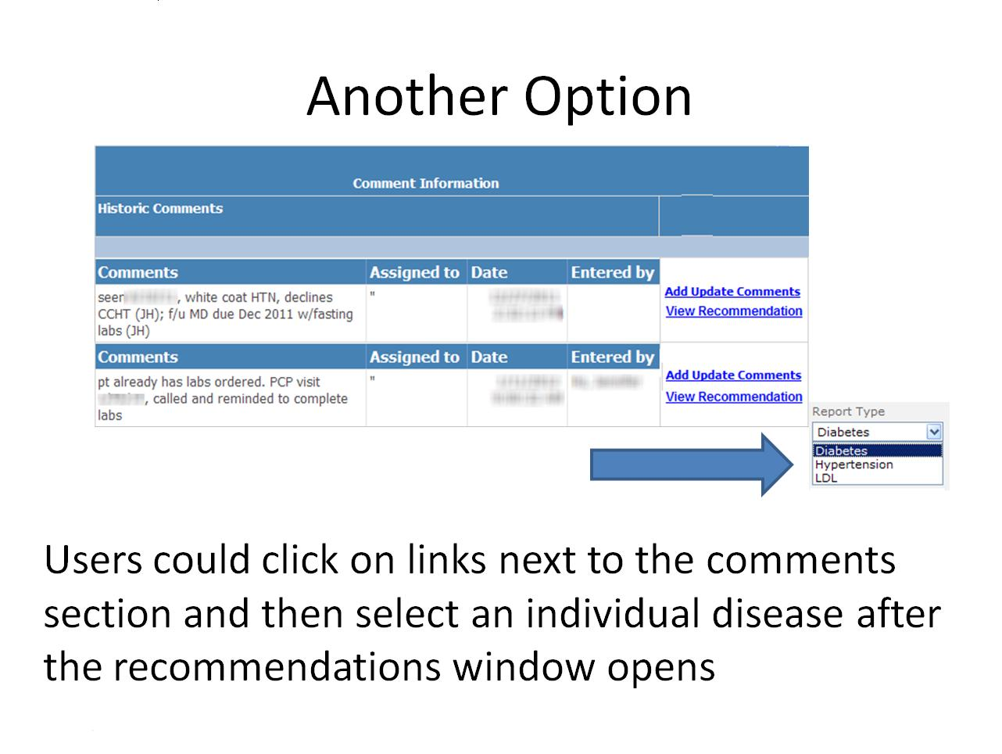
Notes:
This is another option for CDS at the same location in the dashboard. We could put a link to recommendations beside each patient and from there the user could specify which recommendation they would like to see (ex-choose from a drop down menu like the one shown to the right)
Picture adjusted by AMC using Hypersnap 1/19/12

Slide 27
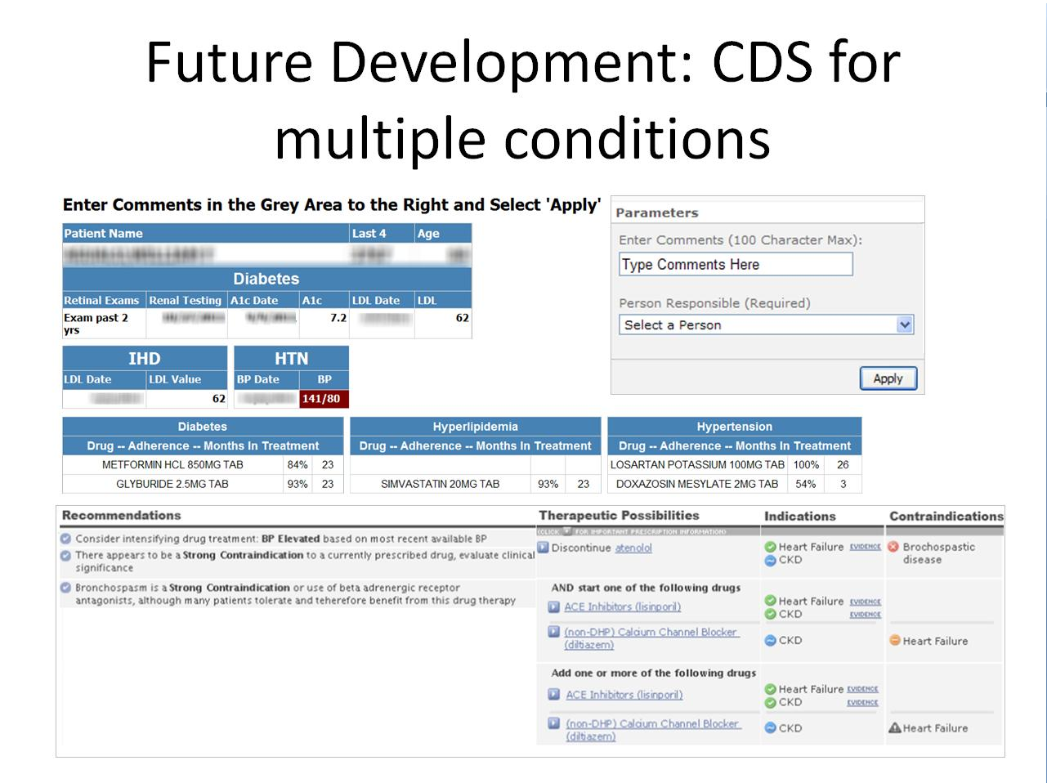

Slide 28
THANK YOU!

Slide 29
Acknowledgements
Funded by HSR&D, grant # IIR 11-071-1
VISN 21 PBM Group
Notes:
Who else to acknowledge?

Slide 30
References
Lee PG, Cigolle C, Blaum C. The co-occurrence of chronic diseases and geriatric syndromes: the health and retirement study. Journal of the American Geriatrics Society 2009;57:511-6.
Boyd CM, Darer J, Boult C, Fried LP, Boult L, Wu AW. Clinical practice guidelines and quality of care for older patients with multiple comorbid diseases. JAMA 2005;294:716-24.

